Slide 1

Unit 4 Introduction

Slide 2
Contents
Section A
Elements and Organization
Section B
Linguistic Strategies

Slide 3

Section A
Elements and Organization
1. Introduction is the first main section of your paper. What are the two general functions of Introduction?
to arouse the readers’ interest ;
2) to offer enough information to prepare readers to understand the paper and to evaluate the findings of the study

Slide 4
Section A
Elements and Organization
2. Study the three main steps in this section
1) Establish research territory
2) Establish a niche
3) Occupy the niche

Slide 5
Section A
Elements and Organization
3. Read the following Introduction section of the research papers to find out how the three major steps in the Introduction are developed.
语言学类论文：
Gong, Z., Liu, Y., & Liu, Y. (2024). A comparative study of research questions written by L1 English authors and Chinese EFL scholars. Journal of English for Academic Purposes, 69, 101383.
文学类论文：
Hoosen, S. (2022). Youth and adolescents' perceptions of violence in post-apartheid South Africa: A systematic review of the literature. Child Indicators Research, 15(1), 87-110.
翻译类论文：
Lee, S. M. (2022). An investigation of machine translation output quality and the influencing factors of source texts. ReCALL, 34(3), 290-310.

Slide 6
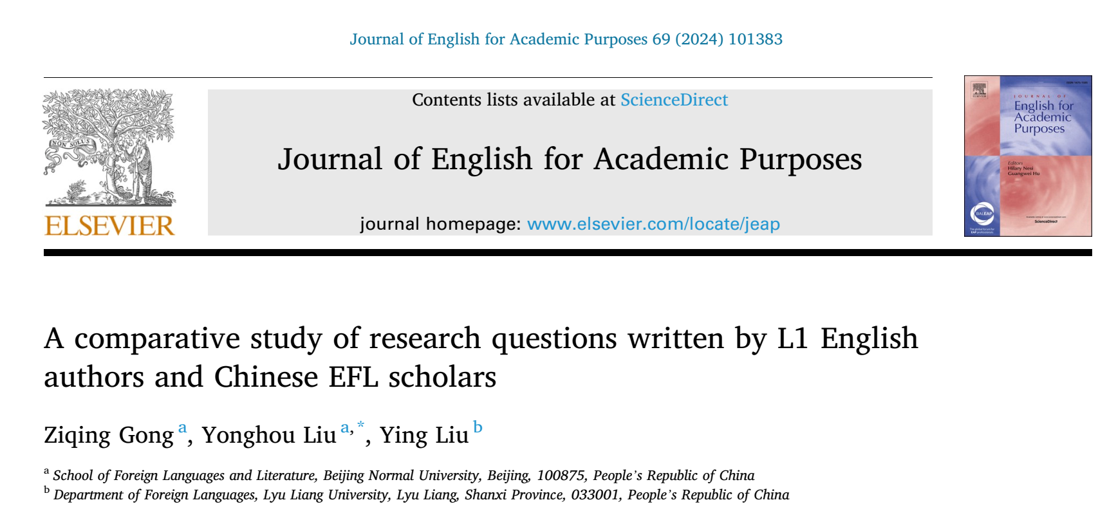
Section A
Elements and Organization

Slide 7
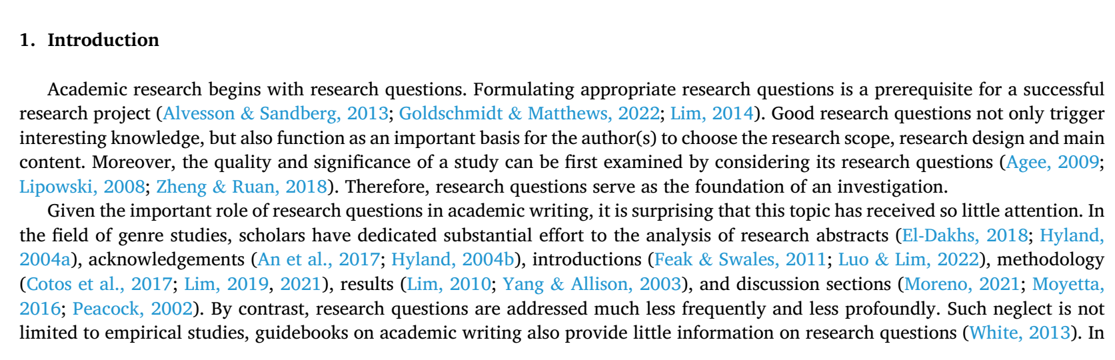
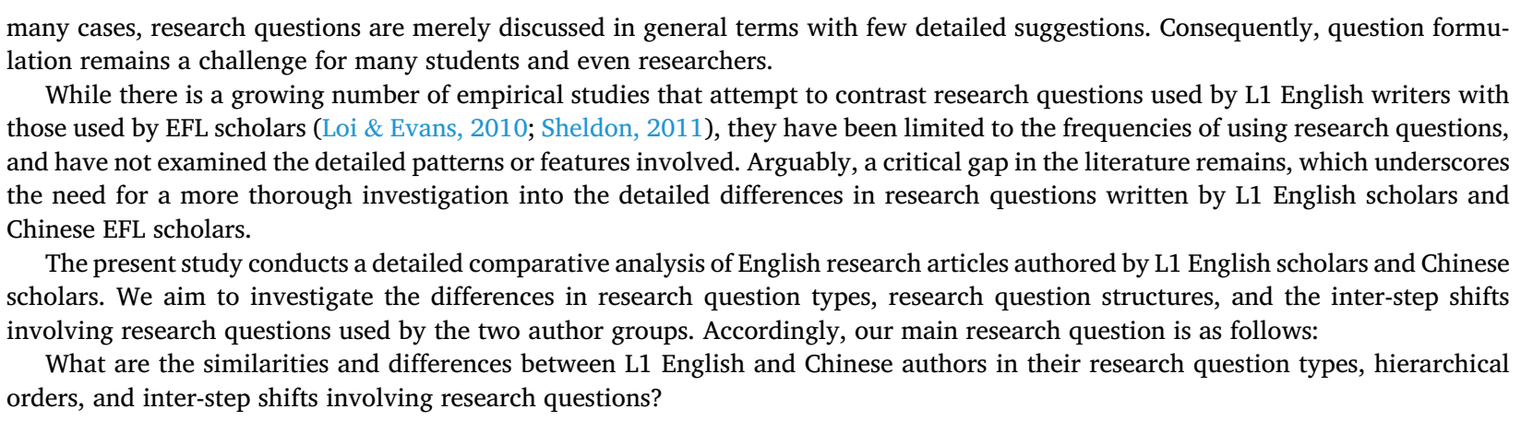

Slide 8
1. Establish research territory
The writer established his research territory:
The importance of formulating appropriate research questions as a prerequisite for successful research is highlighted. The authors note the significant role research questions play in guiding research scope, design, and content, and their critical evaluation in determining the quality and significance of the study .
2. Establish a niche
After literature review, he established the niche: The paper identifies a critical gap in the existing literature, highlighting that while empirical studies contrast research questions used by L1 English writers and EFL scholars, they often lack detailed analysis of patterns and features of these questions. Previous studies have primarily focused on the frequency of research question use rather than their detailed structures and types .
3. Occupy the niche
He occupied the niche: The purpose of the research is clarified by aiming to conduct a detailed comparative analysis of English research articles by L1 English and Chinese scholars. The study seeks to investigate the differences in research question types, structures, and the rhetorical steps surrounding these questions, thereby providing a comprehensive understanding that was previously missing in the literature .

Slide 9
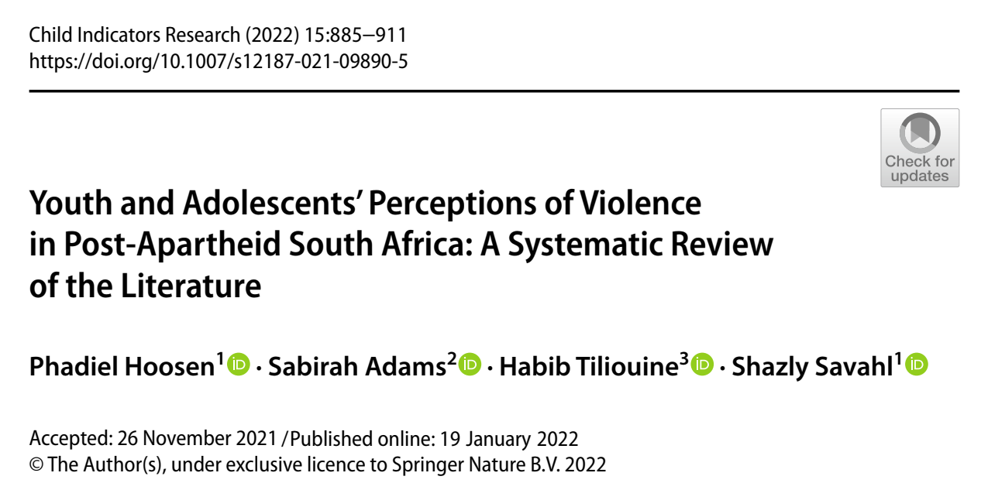

Slide 10
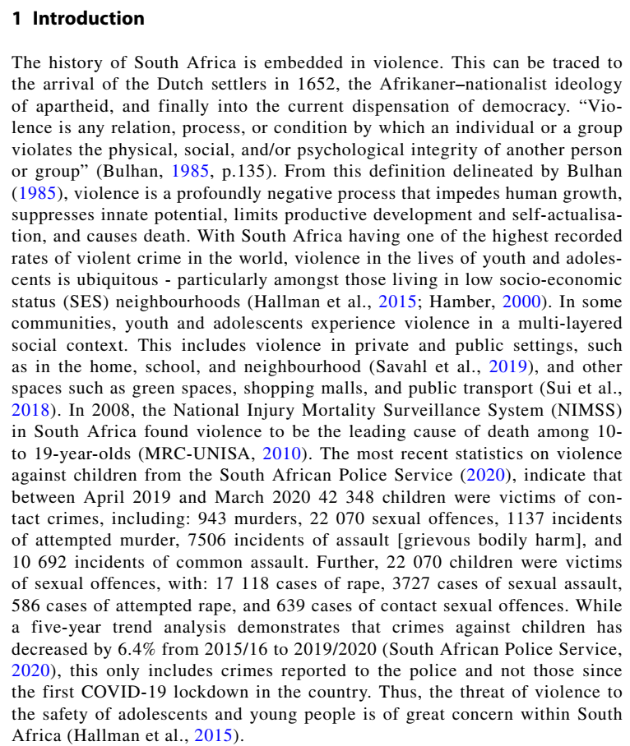

Slide 11
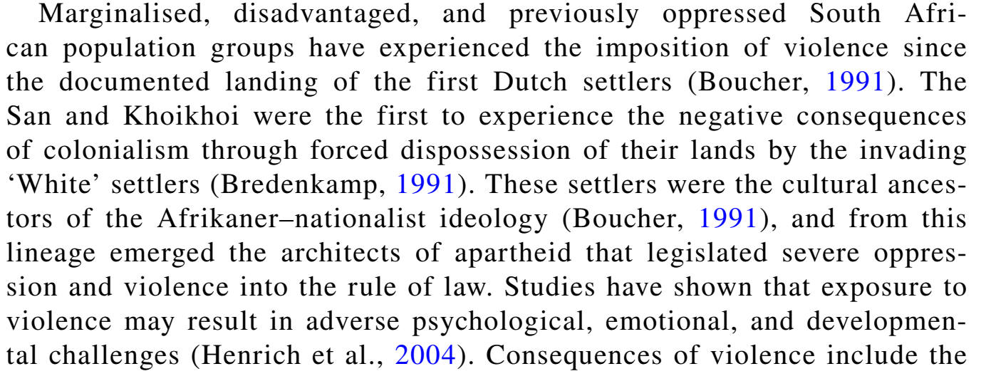
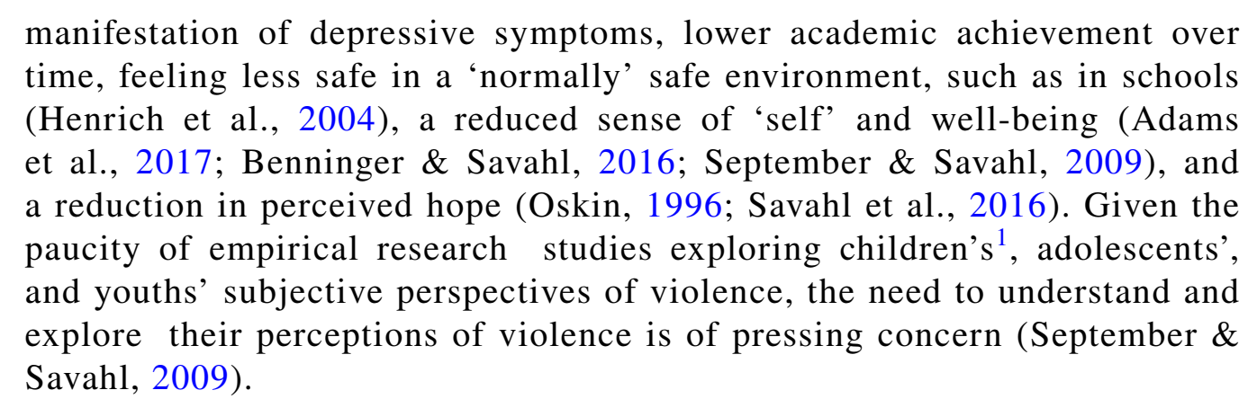

Slide 12
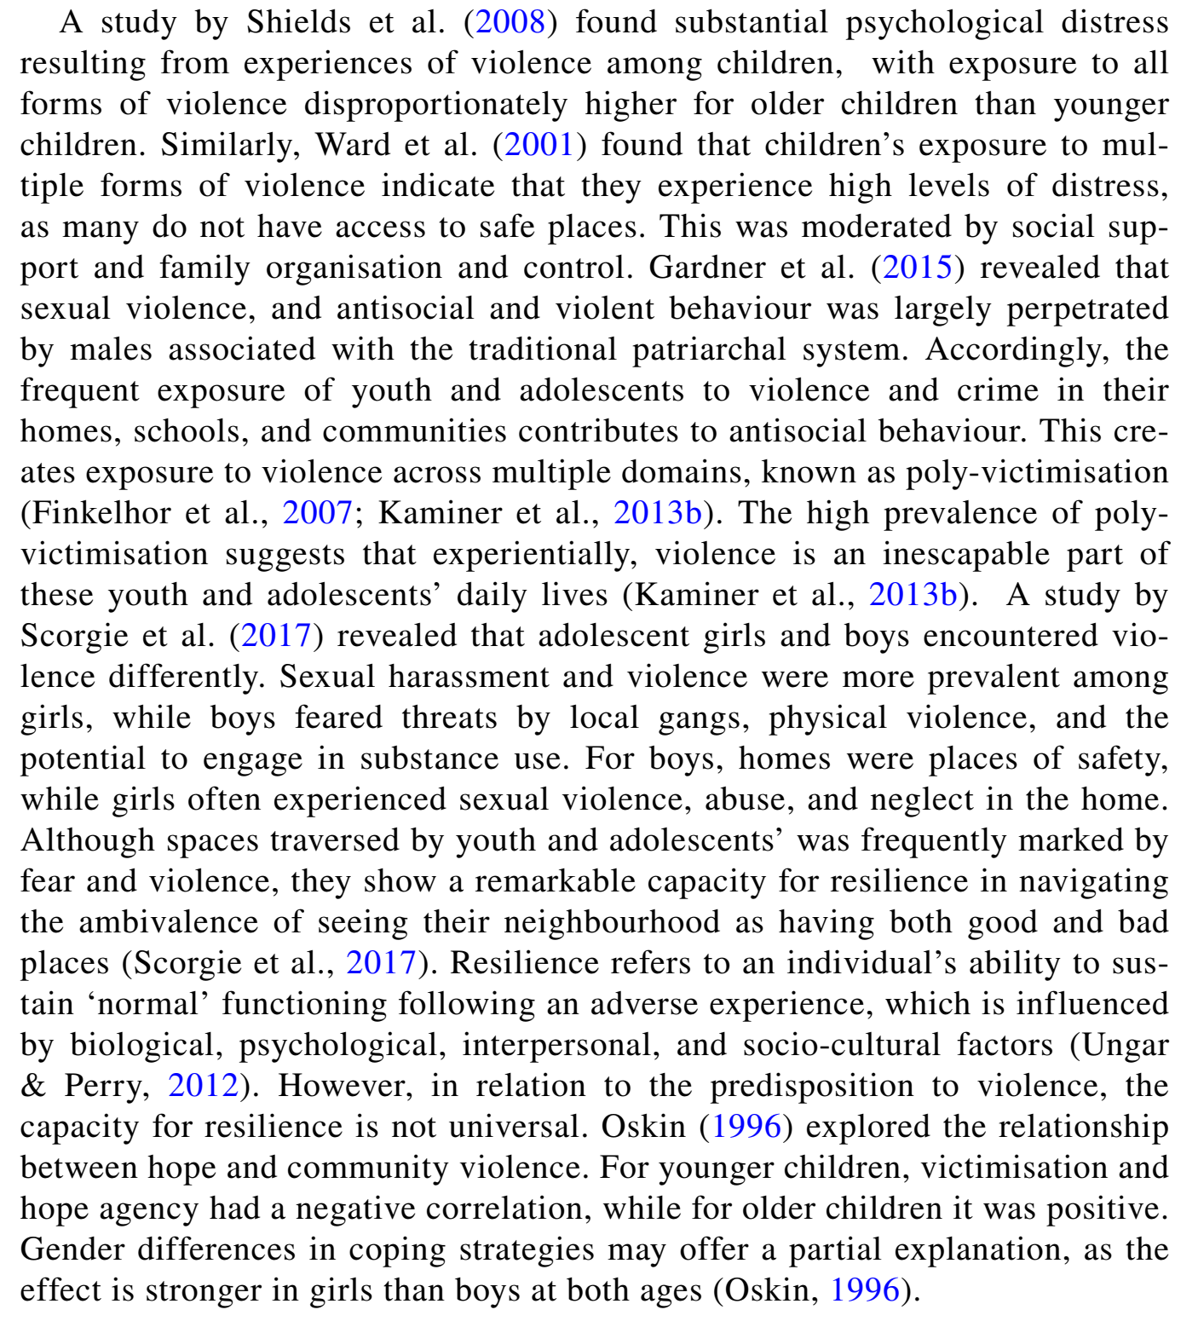

Slide 13
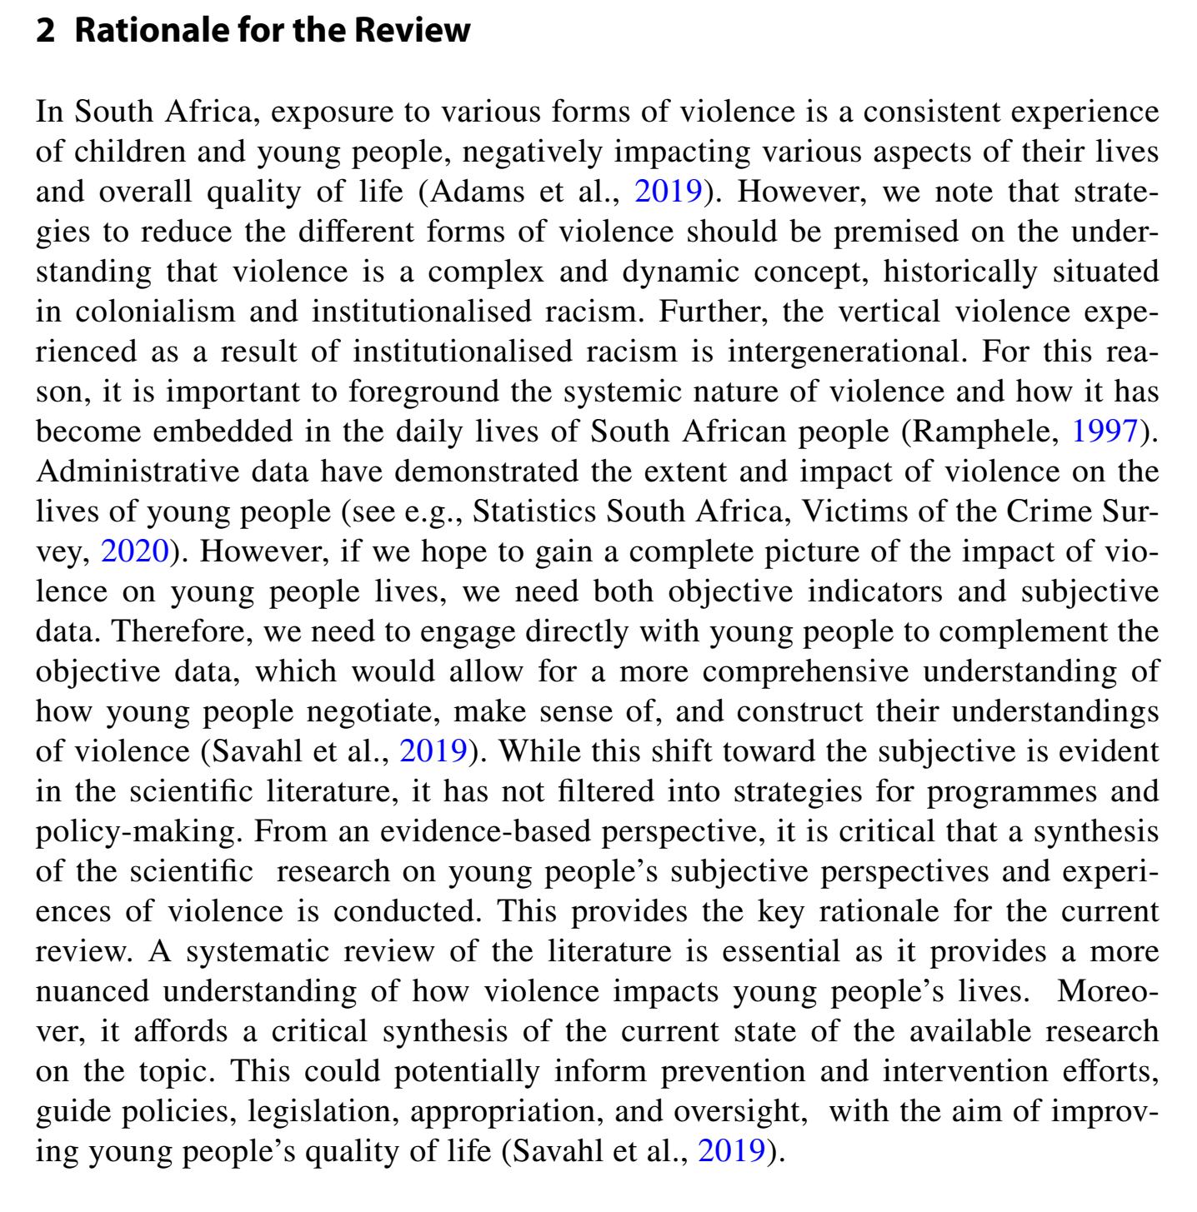

Slide 14
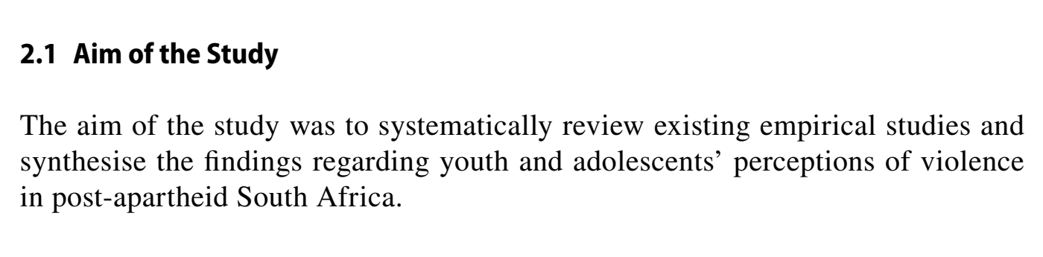
1. 建立研究领域
在后种族隔离的南非，青少年和青少年对暴力的感知成为一个重要的社会问题。
暴力对年轻人的心理、情感和身体健康产生了深远的影响，因此，理解这些感知对于制定有效的干预措施至关重要。
尽管已有大量文献探讨了暴力对年轻人的影响，但对青少年如何感知和体验暴力的系统性研究仍然有限。
2. 确定研究空白
现有的文献综述主要集中在不同类型的暴力及其对青少年的具体影响上，而缺乏对青少年在不同社会和文化背景下对暴力感知的综合分析。此外，尽管一些研究考察了特定地区的暴力问题，但这些研究往往缺乏广泛的比较性视角，无法全面揭示暴力在不同背景下的复杂性。
3. 占据研究空白
本研究旨在通过系统文献综述，探讨南非后种族隔离时期青少年对暴力的感知。研究的目标是汇总现有文献中的主要发现，分析不同研究中所使用的方法和理论框架，并识别研究中的主要趋势和差距。通过这些分析，本研究希望为未来的研究和政策制定提供有价值的见解。

Slide 15


Slide 16
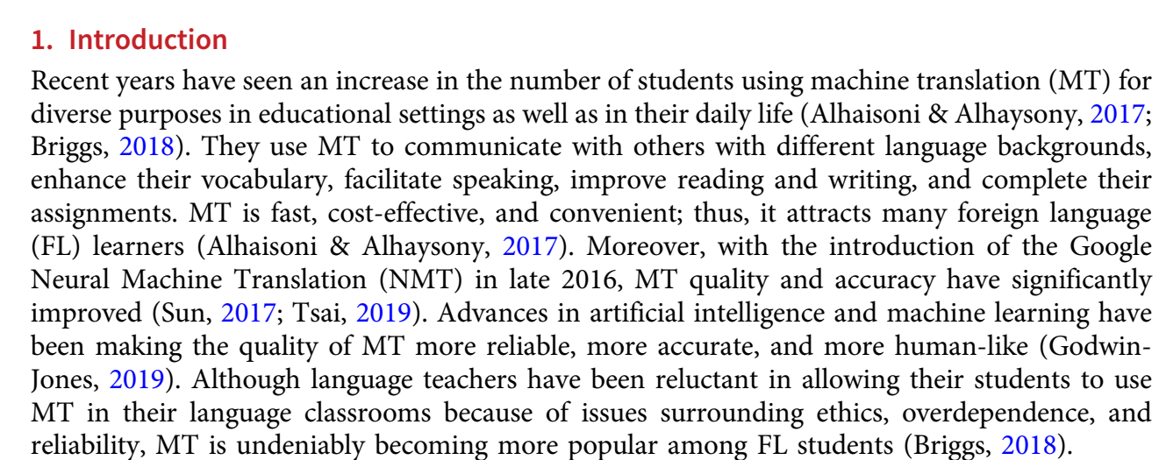

Slide 17
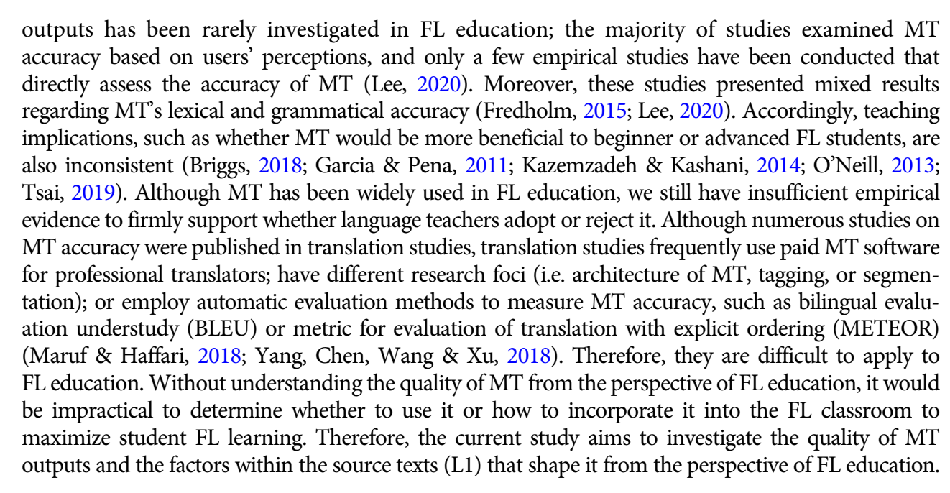

Slide 18

General structure
Recent years have seen an increase in the number of students using machine translation (MT) for
diverse purposes in educational settings as well as in their daily life
However, the majority of studies examined MT accuracy based on users’ perceptions, and only a few empirical studies have been conducted that
directly assess the accuracy of MT
The effectiveness of MT on FL learning and learner satisfaction can, in fact, depend on the MT
output quality
Prior studies have also found several factors that influence MT output quality
Therefore, the present study evaluated the quality of MT outputs by comparing them with student-generated texts in various areas such as comprehensibility, vocabulary, grammar, and punctuation.
18

Slide 19
General structure
An increase number of students using MT for diverse purpose in education settings as well as in their daily life
Although language teachers have been reluctant in allowing their students to use MT in their language classrooms MT is undeniably becoming more popular among FL students
Previous studies have conducted preliminary research
despite its inaccuracies, it remains useful for FL
Education
the quality of MT outputs has been rarely investigated in FL education, examined MT accuracy based on users’ perceptions, few empirical studies directly assess the accuracy of MT
Therefore, the current study aims to investigate the quality of MT outputs and the factors within the source texts (L1) that shape it from the perspective of FL education.
19

Slide 20
Section A
Elements and Organization
3. What should be written in the section of Introduction? Choose from the following questions that you think the answers must be found in Introduction.
1)Why was this study performed?
2)How was exactly the research conducted?
3)What has been done in previous research? Or what knowledge already exists about this subject?
4)What was the specific purpose of the study?
5)What are the explanations for the data?
6)What are the meanings and significance of research results?

Slide 21
Section A
Elements and Organization
4. Rearrange the order of the following paragraphs to form a coherent introduction
1. However, negative attitudes towards these substitutes for conventional paper dictionaries come from a significant proportion of students, parents, as well as foreign language teachers who observe their students consulting their PEDs while answering questions in class, doing reading, listening, and translation work, etc. Although recognizing dictionary consultation as one important means of acquiring English proficiency, the teachers do not care about their own ability to identify what their students’ consultation with PED is like and whether their consultation is too frequent to the extent of damaging their inference ability. Guidance on the best use of PEDs is badly needed.
2. All these analyses were carried out in the ESL environment and the EFL situation in China is different. It is not clear so far what kinds of PED are being used by Chinese EFL students. The study was aimed to fill this gap.

Slide 22
Section A
Elements and Organization
3. It has become increasingly popular in recent years for Chinese foreign language learners in various professions and at all levels to use pocket electronic dictionaries. Combining dictionaries, notebooks, address books, calculators, etc. together, the new, small machines are loved by students with the declared advantages of having multiple functions, being portable and user-friendly.
4. Empirical studies on the efficacy of pocket electronic dictionaries in language learning are in short supply, with the exception of a few pioneering researchers about the futures of PEDs by Hong Kong language educators (Taylor & Chan, 1994; Chi, 1996; Taylor, 1996) and particularly the one by Tang (1997). A language educator at the University of British Columbia, Tang was extremely concerned with the use of PED by Chinese students. A summary of the way of PED consultation was attempted and a couple of users were singled out in particular and their looking up processes were charted.
3
1
4
2
The correct order is _______ , _______ , _______ , _______.

Slide 23
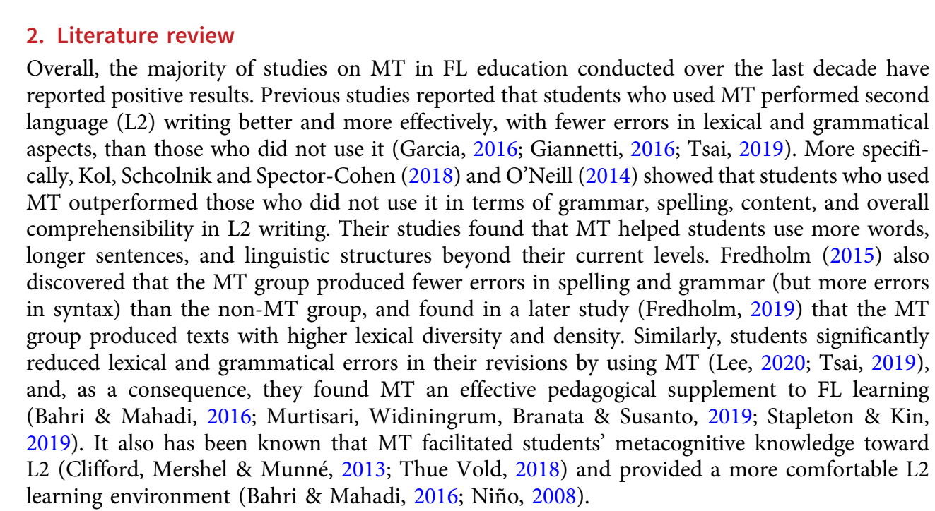

Slide 24
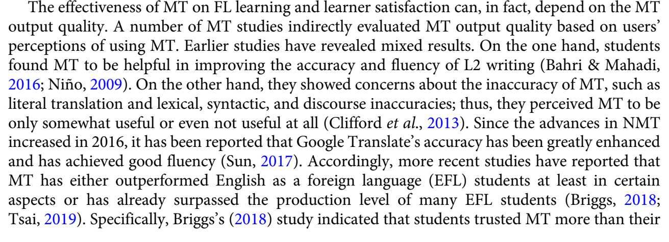
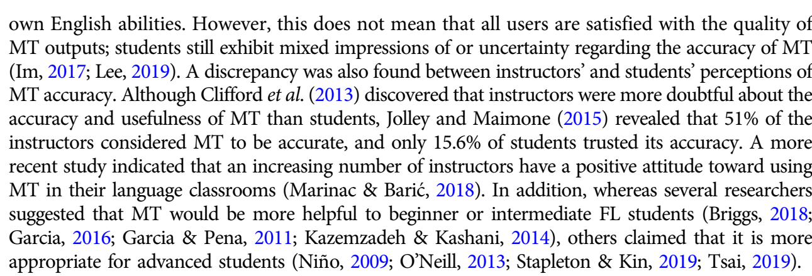

Slide 25
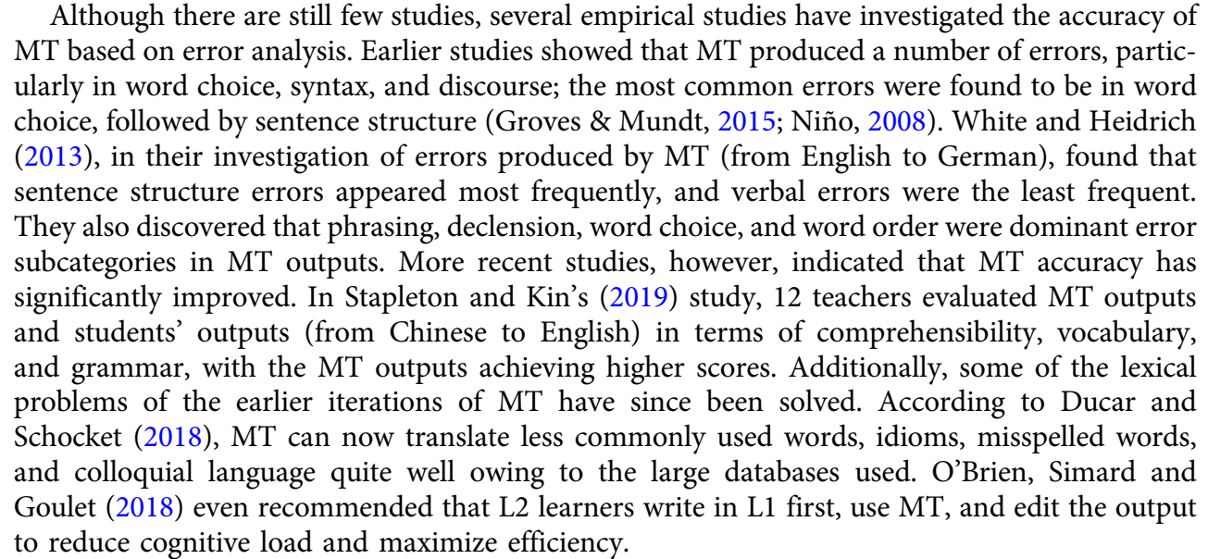

Slide 26
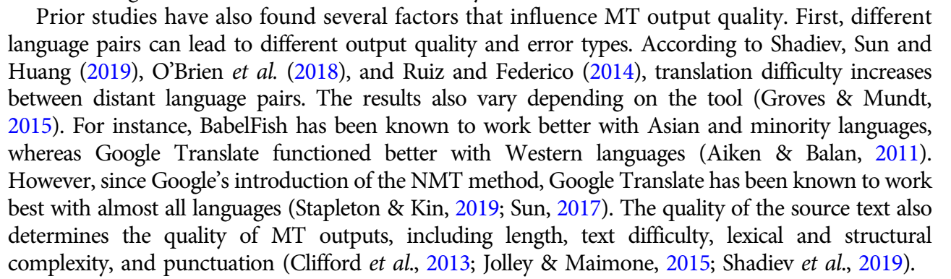

Slide 27
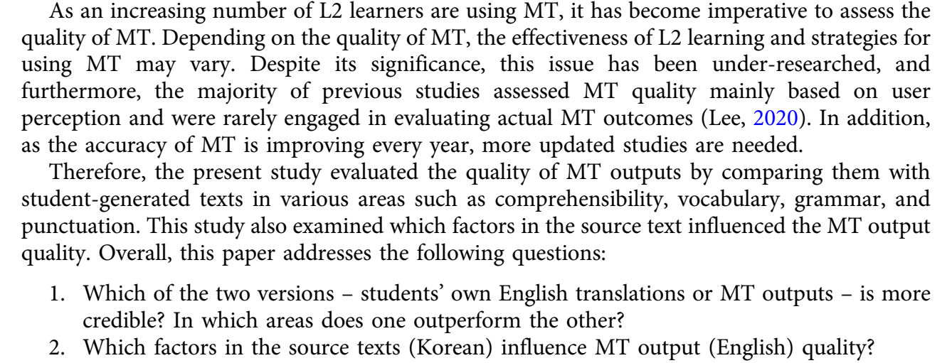

Slide 28

Section A
Elements and Organization
5. Is literature review important in Introduction? Why should we write literature review? Read the Introduction of the paper “Personality and Environmental Concern” and find out the literature for the following functions:
1)To tell us the broad research area
2)To show the focus of much research
3)To explain terminology
6)To inform us theoretical models
7)To show previous findings
8)To show the significance of the study

Slide 29
Section B Linguistic Strategies
Literature Review
1. Do you cite quotations directly or summarize the main ideas when you consult many books and journals to get yourself acquainted with the subject area? To make your references valid and available (they are two vital rules), what can be cited and what can not from the following sources?
1) articles in primary research journals
2) monographs (专论，专著)
3) general knowledge from textbooks
4) lab manuals
5) personal communications
6) unpublished papers
7) general background from encyclopedias
8) academic books
9) data from all kinds of online resources

Slide 30
Section B Linguistic Strategies
Literature Review
The references in a scientific paper must be valid and available.
Articles in primary research journals satisfy both these criteria.
Do not cite general background from encyclopedias, textbooks or lab manuals, etc., because the information is considered common knowledge within the discipline.
Never cite personal communications and unpublished papers, because they are not strong evidence. Furthermore, they must be cited and referenced properly.
Try not to use direct quotation.
9) Currently references from online recourses are widely accepted but the data should be collected from authoritative information sources, such as the electronic edition of core journals and CNKI(China National Knowledge Internet), etc..

Slide 31
literature review
Literature review plays a very important role in Introduction. It provides the research background and shows what has been done in certain field, and gaps in existing knowledge. When you use ideas, findings or results from other sources, be careful to avoid plagiarism ['pleidʒə rizəm]. They must be cited and referenced properly.

Slide 32
Section B Linguistic Strategies
Literature Review
2. Why is it important to cite sources in Introduction as evidence of the claims you are making? Try to summarize the two general models from the following extracts.
Model 1: __________________________________
●Earlier studies showed that MT produced a number of errors, particularly in word choice, syntax, and discourse; the most common errors were found to be in word choice, followed by sentence structure (Groves & Mundt, 2015; Nino, 2008).
However, this does not mean that all users are satisfied with the quality of MT outputs; students still exhibit mixed impressions of or uncertainty regarding the accuracy of MT (Im, 2017; Lee, 2019).
●Model 2: __________________________________
●In Stapleton and Kin’s (2019) study, 12 teachers evaluated MT outputs and students’ outputs (from Chinese to English) in terms of comprehensibility, vocabulary, and grammar, with the MT outputs achieving higher scores.
●
Previous research findings+(researchers+publication years)
researchers +(publication years) + previous research findings

Slide 33
Section B Linguistic Strategies
Literature Review
3. Compare the following three statements. Which one do you think is more valid and convincing?
1) In addition, whereas several researchers suggested that MT would be more helpful to beginner or intermediate FL students ,others claimed that it is more appropriate for advanced students
2) In addition, whereas several researchers suggested that MT would be more helpful to beginner or intermediate FL students (Briggs, 2018), others claimed that it is more appropriate for advanced students (Nino, 2009).
3) In addition, whereas several researchers suggested that MT would be more helpful to beginner or intermediate FL students (Briggs, 2018; Garcia, 2016; Garcia & Pena, 2011; Kazemzadeh & Kashani, 2014), others claimed that it is more appropriate for advanced students (Nino, 2009; O’Neill, 2013; Stapleton & Kin, 2019; Tsai, 2019).

Slide 34
Section B Linguistic Strategies
Literature Review
4. Read the following example. Can you tell how the reference sources are ordered?
In addition, whereas several researchers suggested that MT would be more helpful to beginner or intermediate FL students (Briggs, 2018; Garcia, 2016; Garcia & Pena, 2011; Kazemzadeh & Kashani, 2014), others claimed that it is more appropriate for advanced students (Nino, 2009; O’Neill, 2013; Stapleton & Kin, 2019; Tsai, 2019).

Slide 35
Section B Linguistic Strategies
Literature Review
5. Now you have been equipped with knowledge of reviewing literature and citing sources. Judge the following statements true or false. If true, write T in brackets; if false, write F in brackets.
1)I can cite an unpublished PhD thesis. ( )
2)In Introduction, I must provide all background information whether directly or indirectly related to current research. ( )
3)For a particular statement, it’s advisable to cite more than one source. ( )
4)Reference sources are usually ordered according to their publication date. ( )
5)When using ideas from other sources, I need to paraphrase it in my own words rather than use the exact wording. ( )
F
F
T
F
T

Slide 36
Section B Linguistic Strategies
Establish the niche
6. It is important to give the reasons for the study or establish a niche in Introduction. There’re four different methods to do this:
1.Counter-claiming (introducing an opposing viewpoint or showing weaknesses in previous work);
2.Indicating a gap in previous research;
3.Raising a question about previous research;
4.Continuing a tradition (extending previous research).

Slide 37
Counter-claiming (introducing an opposing viewpoint or showing weaknesses in previous work);
In South Africa, exposure to various forms of violence is a consistent experience of children and young people, negatively impacting various aspects of their lives and overall quality of life (Adams et al., 2019). However, we note that strategies to reduce the different forms of violence should be premised on the understanding that violence is a complex and dynamic concept, historically situated in colonialism and institutionalised racism.
While some scholars argue that the concept of heroism is universally similar across cultures, our research reveals significant differences in how individualistic and collectivistic societies perceive and celebrate heroes.
Previous research often downplays the complexity of human emotions in androids, suggesting a binary view of human versus machine. Our study, however, highlights the nuanced and overlapping emotional experiences that challenge this dichotomy.
Notes:
1. 论文: Hoosen, S. (2022). Youth and adolescents' perceptions of violence in post-apartheid South Africa: A systematic review of the literature.
2. 论文: Sun, Y., & Kinsella, E. (2023). On cultural differences of heroes: Evidence from individualistic and collectivistic cultures.
3. 论文: Wang, Y., & Hao, T. (2022). A study of desires and emotions in 'Do Androids Dream of Electric Sheep?'.

Slide 38
Indicating a gap in previous research
Although previous studies have explored the relationship between power distance and emotional expression, there is a lack of research specifically focusing on how smaller power distances affect the authenticity of emotional expressions in cross-cultural contexts.
Despite extensive research on corrective feedback in classroom settings, there is a notable gap in understanding its impact during telecollaborative language learning, particularly regarding peer versus teacher feedback.
Notes:
论文: Zhu, X., Tian, G., & Liu, Z. (2022). The smaller the power distance, the more genuine the emotion: A cross-cultural study of power distance and emotional expression.
论文: Sippel, L. (2024). Is corrective feedback during telecollaboration beneficial? The effect of peer and teacher correction on L2 writing proficiency.

Slide 39
Raising a question about previous research
While existing literature extensively covers the usage of stative verbs, it remains unclear how the perception of intensity differs between simple and progressive aspects. This raises the question: How do these grammatical aspects influence the perceived intensity of stative verbs like 'believe’?
Previous studies suggest metaphors are powerful in conveying complex emotions, but how effective are they specifically in the context of mental health advertisements in Chinese culture? This study seeks to answer this question.
Notes:
论文: Taguchi, N. (2023). Stative verbs and perception of intensity: The case of 'believe' in simple and progressive aspect.
论文: Pan, X., & Xie, Y. (2023). The effectiveness of metaphor in Chinese video advertisement for depression: An experimental study.

Slide 40
Continuing a tradition (extending previous research).
This study builds on the established research on audiovisual translation (AVT) and further explores how communicative rituals are represented in subtitles, extending the analysis to the depiction of cultural otherness and the strategies employed by translators to convey these elements effectively.
This study continues the tradition of literary analysis using Marxist theory, specifically Lukacs’ perspective, to delve deeper into the representation of the American Dream in 'The Great Gatsby’.
Building on previous research in political discourse analysis, this study extends the examination of metaphor use in governmental negotiations, focusing on the trade talks between Trump and Xi.
Notes:
Marie-Noëlle Guillot (2017). Communicative Rituals and Audiovisual Translation: Representation of Otherness in Film Subtitles.
Yuan, J. (2021). An analysis of Gatsby's American Dream in 'The Great Gatsby' from the perspective of Lukacs.
Tan, X. (2024). A dynamic metaphor perspective on Trump and Xi's trade negotiation in governmental discourse.

Slide 41
Section B Linguistic Strategies
Establish the niche
7 Read the introduction section of the three papers of your own, and find out what method is used to establish a niche and fill in the following table.
Appendix | Counter-claiming | Indicating a gap | Raising a question | Continuing a tradition
1
2
3

Slide 42
Section B Linguistic Strategies
a)Few studies/investigations/researchers/attempts...
b)The aim/purpose/of this paper/investigation is to give...
c)Recently, there have numerous publications reporting on...
d)This study was designed/conducted to evaluate...
e)We can now hypothesize with some confidence that...
f)Researchers have recently focused their attention on...
g)However, there exists little research/attention...
h)We have put forward a hypothesis to test...
i)Recently, there has been growing interest in/concern about...
j)None of these studies/findings prove...
k)It is the purpose of the present paper to provide...
l)There is, however, little information/attention/work/research/regarding...
m)Two hypotheses regarding...are formulated as follows:
n)There have been few specific reports in the literature of...
1)Specifying the purpose of the research: _________________________________
2)Indicating the limitation of previous study: ______________________________
3)Making a hypothesis of the research: __________________________________
4)Introducing the importance of the research area: _________________________
b d k
a g j l n
e h m
c f i

Slide 43
Section B Linguistic Strategies
Language characteristics
7. When writing the Introduction section, use active voice as much as possible. It is fine to use first person, but do not overuse it. Simple present tense, present perfect tense and simple past tense are three main verb tenses used in this section.

Slide 44
Section B Linguistic Strategies
Language characteristics
We aim to conduct a detailed comparative analysis of English research articles by L1 English and Chinese scholars
We have identified several key factors that influence the quality of machine translation outputs.
We conducted a systematic review of existing literature on the perceptions of violence among youth and adolescents in post-apartheid South Africa.
We explore the differences in how individualistic and collectivistic societies perceive and celebrate heroes.
We have highlighted the nuanced and overlapping emotional experiences that challenge the dichotomy of human versus machine.

Slide 45
Section B Linguistic Strategies
Language characteristics
8 The following part is excerpted from an introduction of an academic paper. Please fill in the blanks with correct forms of the verbs in brackets.
According to Spolsky, there ____________ (be) three main trends in the area of language testing: the pre-scientific approach, the psychometric-structuralist approach, and the Psycholinguistic-sociolinguistic approach. Multiple choice ____________ (be) just one of the testing techniques resulting from psychometric- structuralist approach. This approach ____________ (believe) that testing can be objective, precise, reliable and scientific. This ____________ (lead), on one hand, to the development of techniques to make traditional tests more reliable, and, on the other hand, to the development of tests with multiple choice questions (Theo van Els 1984: 325). MC ____________(use) only in discrete-point test then. Although testing theories ____________ (advance) over the last few decades, MC ____________ (inherit) thereafter as a valuable testing technique.
are
is
believes
led
was used
advanced
Has been inherited

Slide 46
Section B Linguistic Strategies
8 The following part is excerpted from an introduction of an academic paper. Please fill in the blanks with correct forms of the verbs in brackets.
However, it ____________ (seem) that due importance has not yet been attached to MC in language testing for the past few years. Checking the Whole- length Database of Chinese Academic Journals, the authors ____________ (find) that of nearly 21,600 papers concerning English teaching and research, only eight are about MC.
It ____________(be) a bare fact that MC is an indispensable part of many authoritative English tests, such as CET, WSK, TOEFL, and GRE. But its designing principles and regulations are rarely touched upon. This paper, hoping to draw some attention to the design of MC, ____________ (bring forth) two fundamental principles in the design of vocabulary MC options.
seems
found
is
brings forth

Slide 47
Summary
Section A
A good beginning is half done, so is a research paper. Composing the introduction section is of great importance. In terms of structure, a well-organized introduction presents a funnel shape, or in other words, it begins with general research topic and then narrow down to the research focus. A three-move pattern which refers to establishing research territory (move 1), establishing a niche (move 2) and occupying the niche (move 3) can be applied to writing up the introduction part.
Section B
In move 1, literature review is indispensable because it provides the research background and shows what has been done or what has been known in certain field. When reviewing literature, it is compulsory to indicate the sources. There are two models of citing sources. Model 1: previous research findings + (researchers + publication year); Model 2: researchers + (publication year) + previous research findings. In move 2, there are four methods to establish a niche: counter-claiming, indicating a gap in previous research, raising a question about previous research, and continuing a tradition. A niche is established which is signaled by some words indicating a contrast or negative evaluation. In move 3, research purposes are directly or indirectly stated.

Slide 48

Thank You

